Slide 1





4X4 Training program
PORTFOLIO
Srihari

Slide 2
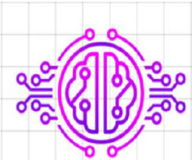
About CEREBRATECH
We’re thrilled to have you onboard as
part of our growing community.
Together, let’s innovate, learn, and build
solutions for tomorrow!
Cerebra Tech is a dynamic startup
specializing in developing end-to-end
projects using modern technologies
Our mission is to deliver impactful
solutions while fostering a culture of
innovation and continuous learning

Slide 3
Day-1
Python Programming Bootcamp
Overview:
The Python programming course was delivered in a single, intensive session. The experience was both engaging and insightful, making it easy to quickly grasp the concepts.
Here's a revised version:
Assignments: Completed 13 hands-on assignments that comprehensively covered all major Python topics
Key Topics Covered:
Basics of Python: Variables, data types, and operators.
Control Flow: If-else statements, loops, and nested constructs.
Functions: Creating reusable code blocks and working with parameters.
Data Structures: Lists, tuples, dictionaries, and sets.
Object-Oriented Programming (OOP): Classes, objects, inheritance, and polymorphism.

Slide 4
Day-2
Focused on Understanding MySQL and Its Usage for Managing Relational Databases
Work Done:
Learned MySQL Fundamentals: Covered basic SQL operations such as SELECT, INSERT, UPDATE, DELETE, and JOIN, along with understanding database schema, normalization, and relationships between tables.
Practice Questions: Completed 100 practice interview questions to solidify MySQL concepts. These questions helped in mastering query writing, database manipulation, and data retrieval techniques.
Solved 50 Challenging Questions: Tackled 50 questions from the training, applying advanced SQL concepts like subqueries, indexing, complex joins, and aggregate functions. This hands-on practice improved the ability to write efficient SQL queries and troubleshoot database-related issues.

Slide 5
Key Learning: Developed a deeper understanding of relational databases, including managing large datasets and optimizing queries for better performance.
Hands-On Practice
Writing a query to retrieve data from a table:
SELECT name, age FROM students WHERE age > 18;
Writing a query to retrieve data from a table:
INSERT INTO students (name, age, grade) VALUES ('John
Doe', 20, 'A');

Slide 6
Day-3
Learning NumPy, Pandas, Matplotlib, and EDA (Exploratory Data Analysis)
NumPy:
Focused on key data analysis libraries like NumPy, Pandas, and Matplotlib, along with performing Exploratory Data Analysis (EDA) on datasets. Covered topics such as detecting outliers and addressing class imbalance.
Overview:
NumPy is a Python library for efficient numerical computing, providing support for multi-dimensional arrays and matrices. It offers a wide range of mathematical functions for operations on large datasets.
Pandas: Pandas is a Python library for data manipulation and analysis, offering flexible data structures like DataFrames and Series. It simplifies tasks such as data cleaning, transformation, and exploration with intuitive indexing and powerful functions.

Slide 7
Matplotlib: Learned how to visualize data using Matplotlib, creating various types of plots like line charts, bar charts, and histograms.
Exploratory Data Analysis (EDA): Performed EDA to understand the dataset's structure, detect outliers, and handle class imbalance.
Outliers: Identified outliers in the dataset using statistical methods and visualizations.
Class Imbalance: Addressed class imbalance by applying techniques like resampling and using visualization methods to understand the imbalance.
Machine Learning: Machine Learning is a branch of Artificial Intelligence (AI) that focuses on building systems capable of learning from data and improving their performance over time without explicit programming. ML algorithms analyze large datasets to identify patterns, make predictions, or make decisions based on input data.
Types of Machine Learning:
- Supervised Learning
- Unsupervised Learning
- Reinforcement Learning
Real-World Applications:
- Healthcare
- Finance
- Retail
- Transportation

Slide 8
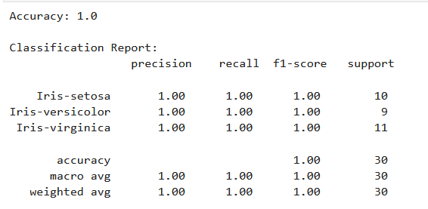
Typical ML Workflow:
- Data Collection
- Data Preprocessing
- Model Selection
- Training
- Evaluation
- Deployment
I have done project Iris by using iris dataset
SepalLength
SepalWidth
PetalLength
PetalWidth
It will tell that what it is in these following
Setosa
Versicolor

Slide 9
Day-4
Deep learning
Deep Learning is a subset of machine learning that uses multilayered neural networks to simulate the decision-making power of the human brain. Unlike traditional machine learning models, deep learning models use many layers to learn complex features and perform sophisticated tasks.
Key Concepts:
Neural Networks: Layers of interconnected nodes that process information.
Forward Propagation: Data moves through the network from input to output layers.
Backpropagation: Adjusts weights and biases to correct prediction errors.

Slide 10
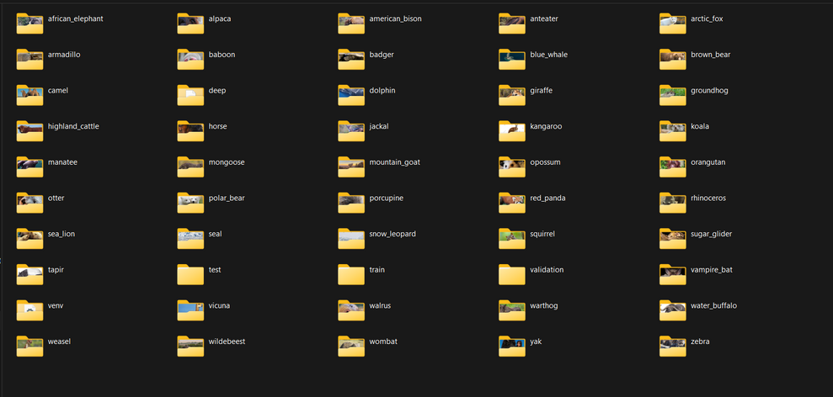
Applications:
- Digital assistants
- Voice-enabled devices
- Credit card fraud detection
- Self-driving carsa
- Generative AI
Deep learning enables systems to learn from vast amounts of data and improve their performance over time.

Slide 11
Thank-you

